Slide 1
DATABUSTERS 2026
Financial Run Dynamics
When the $1 promise breaks: the 2008 Reserve Primary Fund and the 2022 Terra-Luna collapse
~$40B
72 hrs
redeemed from one money fund
within two days, Sept 2008
for Terra-Luna to wipe out
~$50B in value, May 2022
M1G · Aung Oakgar · Jerome Yeoh · Kwang Yu Cong · Seow Yi Le · Wu Jun Hao

Slide 2






THE THESIS
Two crises, one anatomy of a run
Fourteen years and an entire financial paradigm apart, both episodes ran the same five-step script. A run is not a technology problem; it is a confidence problem [1][2].
1
2
3
4
5
→
→
→
→
The promise
The trigger
The break
The panic
Who pays
An asset is marketed as a riskless $1, redeemable on demand.
A macro shift exposes the fragility hidden behind the peg.
The peg snaps; “$1” is suddenly worth less than a dollar.
First-mover advantage turns caution into a rush for the exit.
Losses land wherever there is no backstop to absorb them.
2008 Reserve Primary Fund
2022 Terra-Luna (UST)
Regulated money market fund · backed by short-term commercial paper · publicly backstopped
Algorithmic stablecoin · “backed” by its own sister token · no insurance, no lender of last resort
Sources: [1] Gorton 1988 · [2] Anadu et al. 2025 (FRB Boston)
02

Slide 3

THE PROMISE
The illusion of safety: engineering a $1
2008 · Reserve Primary Fund
2022 · TerraUSD (UST)
The promise
Redeem each fund share for exactly $1 on demand.
Swap each UST for exactly $1 on demand.
How the peg held
Short-term commercial paper, including $785M of Lehman Brothers debt.
Algorithmic mint-and-burn arbitrage with its sister token, LUNA.
The hidden assumption
An “A”-rated note from a 158-year-old bank felt riskless, mistaking short duration for no risk.
A $40B, heavily-traded LUNA felt like real reserves, mistaking market cap for cash.
The blind spot
Financial-sector paper was ~56% of the portfolio, correlated with the crisis itself.
~72% of all UST sat in one DeFi platform, Anchor, chasing a ~20% yield.
The common flaw: in both cases the asset “backing” the dollar was correlated with the very panic it was meant to survive. A stable $1 reading disabled investors’ alarm system until it was too late.
Sources: [3] Liu, Makarov & Schoar 2023 (NBER) · [5] Makhija 2025 (Yale J. Financial Crises) · [7] Decrypt 2022 · [9] TheStreet 2025
03

Slide 4

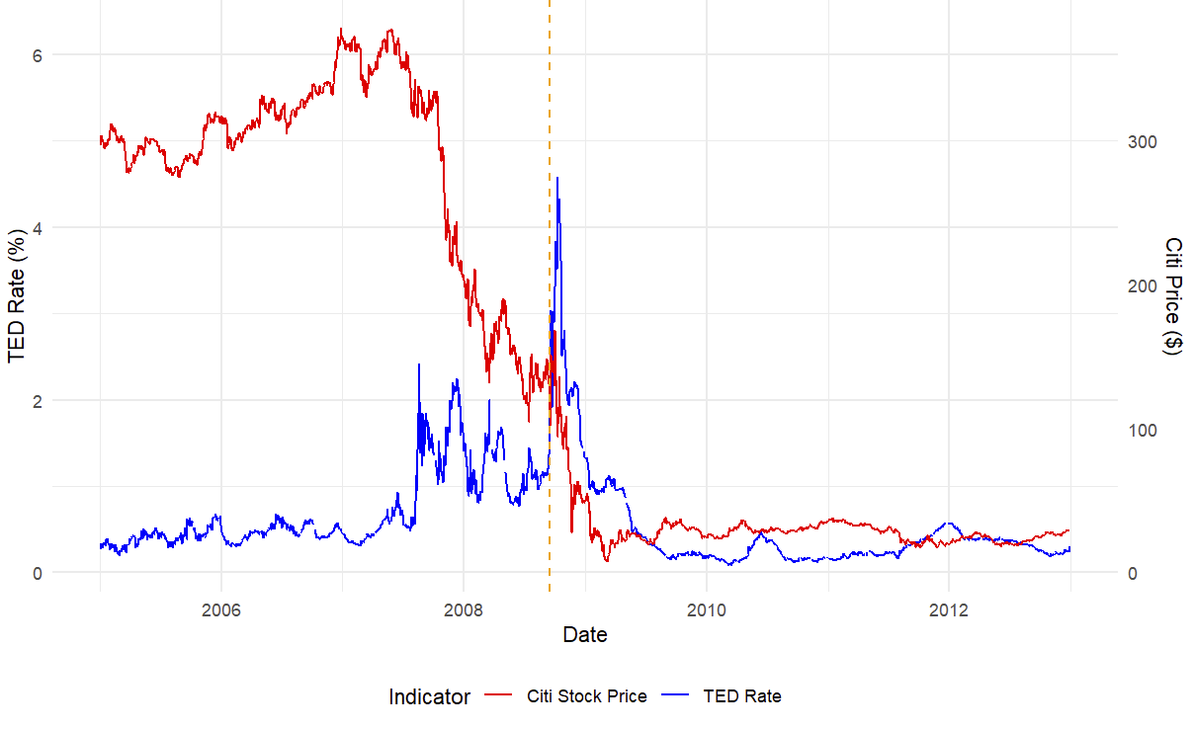
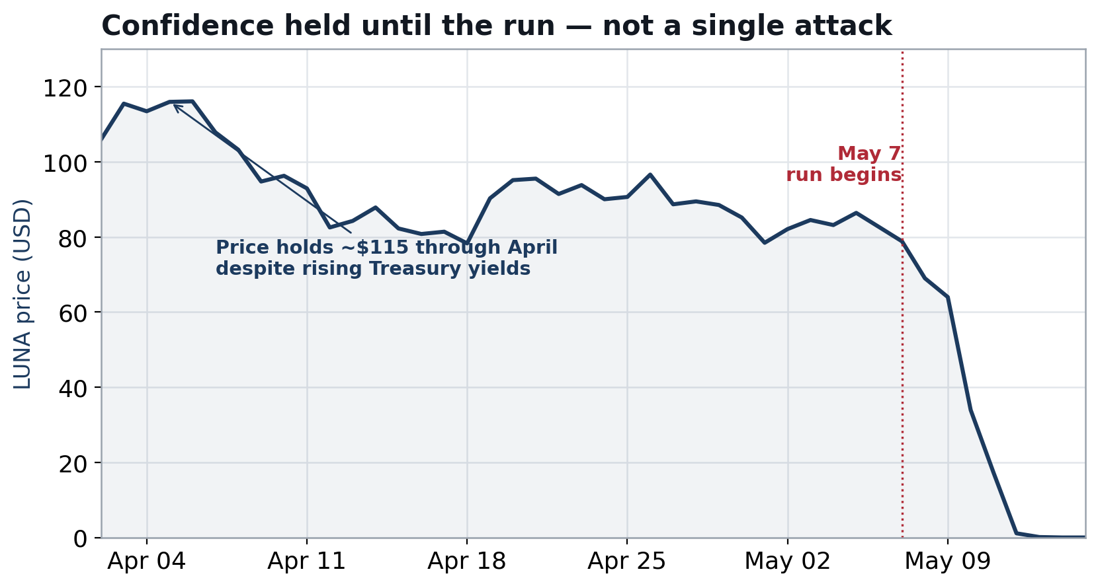
ONSET · SECTION A Q1
The macro trigger: rising rates exposed the rot
2008: stress was visible before Lehman
2022: a slow erosion, not one attack
Through 2007–08 the TED spread climbed from under 0.5% toward 4.6% as banks stopped trusting each other’s mortgage exposure; financial equities (Citi, as a proxy) fell in step. Lehman’s bankruptcy was the final shock, not the first crack [4][5].
Near-zero Fed rates had made Anchor’s 20% yield irresistible. As the Fed began hiking in 2022, risk-free Treasuries grew attractive and the yield premium thinned. LUNA still held ~$115 through April despite two large sell-offs; confidence eroded gradually before the run began [3][8].
Sources: [3] NBER 2023 · [4] Gorton & Metrick 2010 · [5] Yale 2025 · [8] Chainalysis 2022 · 2022 prices: provided dataset
04

Slide 5

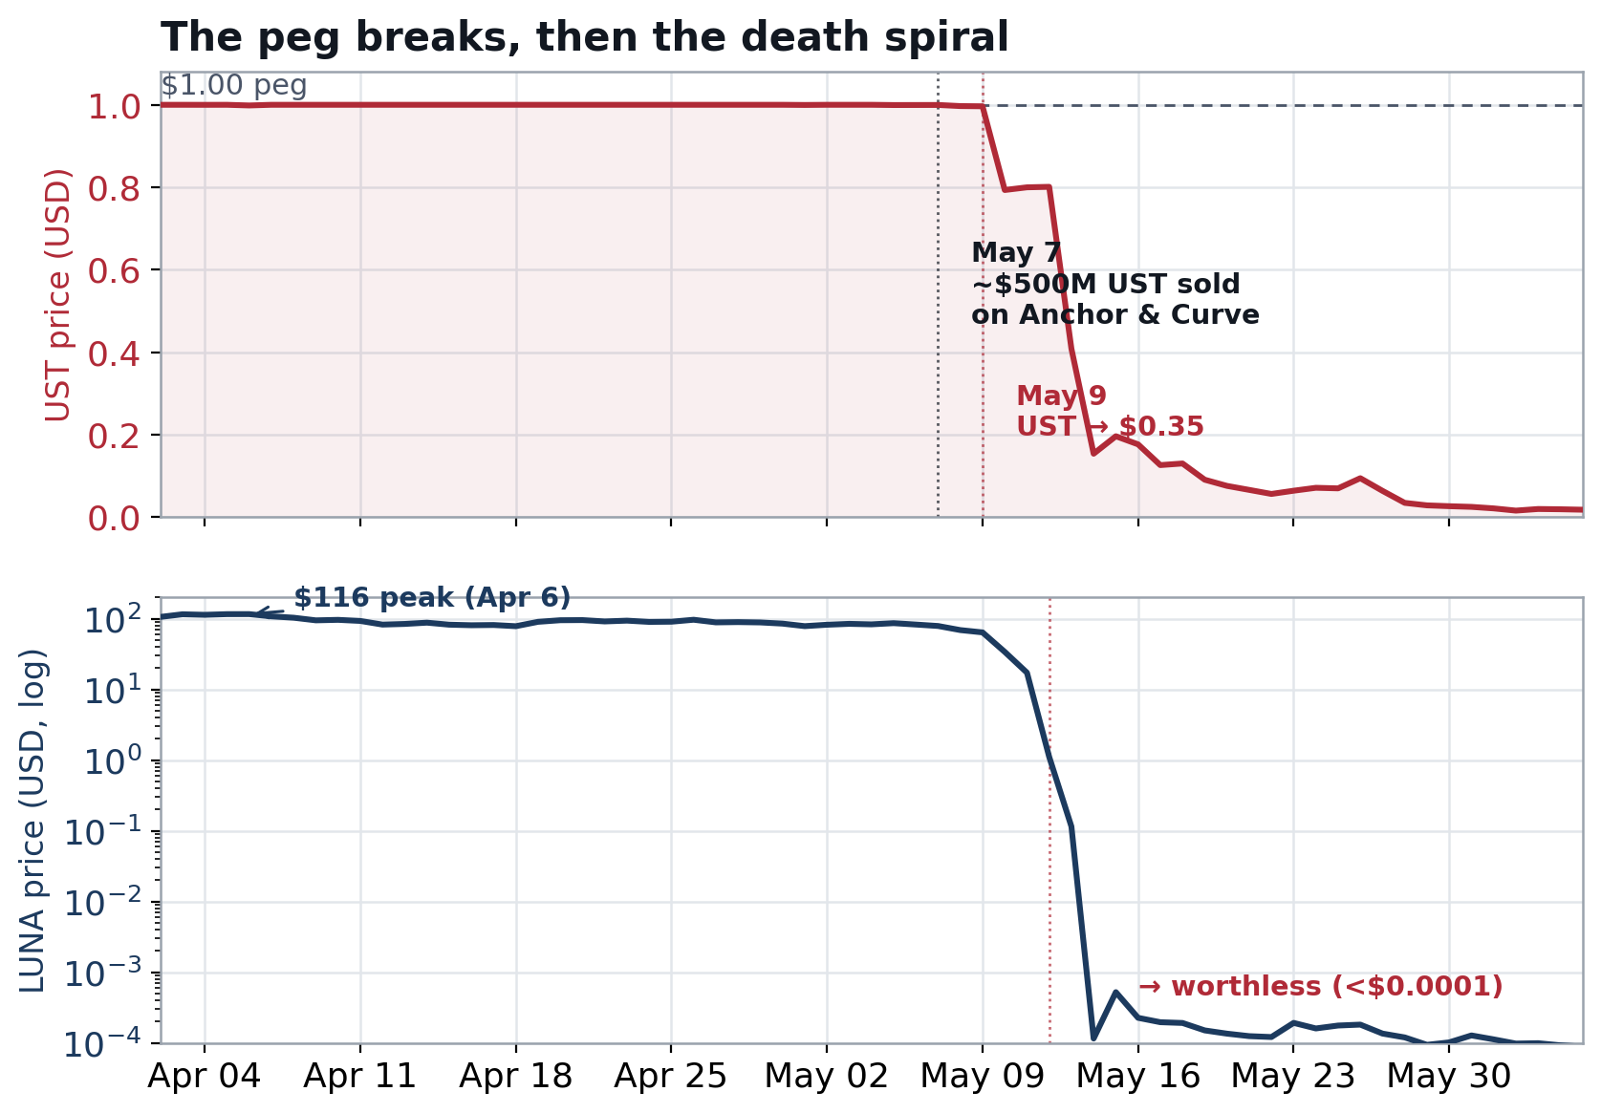
THE BREAK · SECTION A Q1
When the peg breaks: onset and spread
The accounting break, 2008
Lehman’s paper was written down to $0. A 1.2% loss pushed the fund’s NAV below the $0.995 rounding threshold; on 16 Sep it “broke the buck” and re-priced at $0.97 [5][6].
The algorithmic break, 2022
To defend the peg the protocol minted LUNA to buy back UST. Selling overwhelmed the mechanism: LUNA’s supply hyper-inflated and its price fell 99% by 12 May, destroying the very collateral meant to anchor UST [3][9].
Fig. 1 TerraUSD held its peg until 7 May 2022, then collapsed within days; as the protocol minted LUNA to defend it, LUNA’s price fell from ~$116 to a fraction of a cent (log scale).
Sources: [3] NBER 2023 · [5] Yale 2025 · [6] Yale New Bagehot Project · [9] TheStreet 2025 · 2022 prices: provided dataset
05

Slide 6

PROPAGATION · SECTION A Q1
Why panic spreads: redeem first, ask later
Core mechanism. Runs propagate through imperfect information. Once one “safe” asset fails, no one can instantly tell which peers are sound; the rational move is to redeem before everyone else does. The first-mover advantage turns individual caution into a collective stampede [1][2].
2008 · The prime money-fund run
2022 · The stablecoin contagion
Reserve Primary broke the buck. Investors feared other prime funds also held Lehman and financial-sector paper.
~$300B was pulled from prime funds in a single week, with over $400B of total money-fund redemptions by 1 October.
Forced asset sales froze the commercial-paper market, cutting off banks’ short-term funding [5][6][4].
UST’s failure proved a top-three stablecoin could die, and holders could not tell which coins were truly liquid.
USDT briefly slipped to $0.9959 as redemptions surged; DeFi collateral was liquidated across lending protocols.
Falling crypto prices fed further withdrawals; lenders 3AC, Celsius and Voyager failed within weeks [9][10].
Sources: [1] Gorton 1988 · [2] Anadu et al. 2025 · [4] Gorton & Metrick 2010 · [5] Yale 2025 · [9] TheStreet 2025 · [10] Bitstamp
06

Slide 7

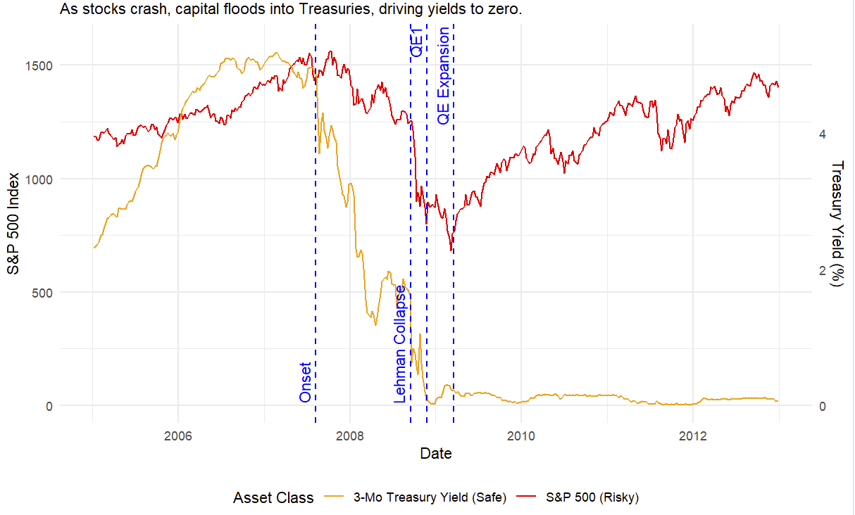
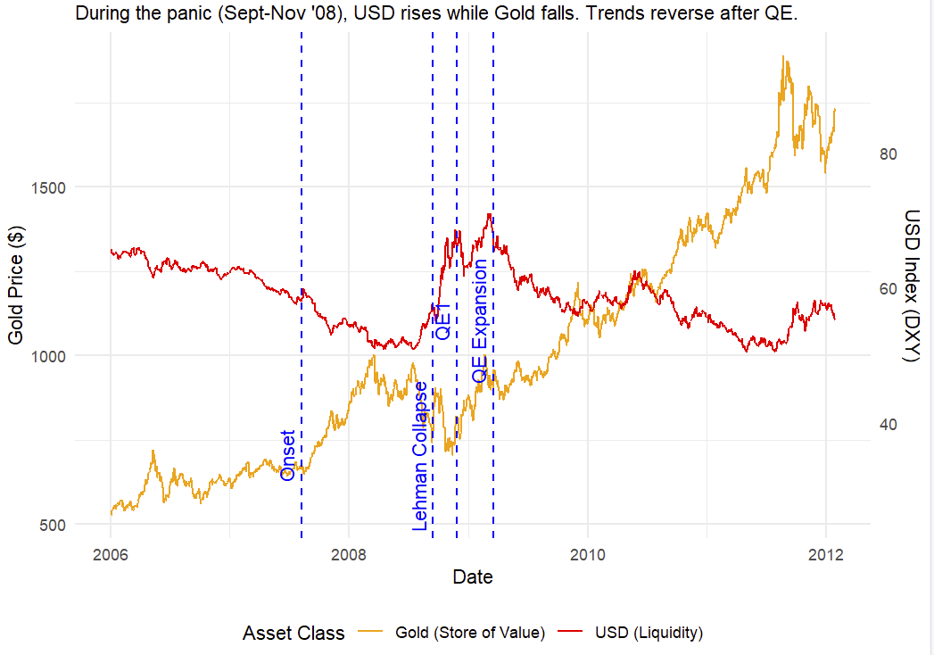
WHERE THE MONEY GOES · SECTION A Q2
Flight to safety, 2008: into Treasuries
As equities crashed, capital flooded into short-term Treasuries, driving the 3-month yield toward zero; investors were effectively paying for safety. During the Sept–Nov panic the dollar spiked (a global scramble for USD liquidity) while gold fell; the pattern reversed once the Fed flooded markets through swap lines and quantitative easing [6].
Takeaway: in 2008 the safe haven was government money: Treasuries and the dollar itself.
Sources: [6] Yale New Bagehot Project · 2008 series: provided GFC dataset (3-mo Treasury, S&P 500, gold, DXY)
07

Slide 8

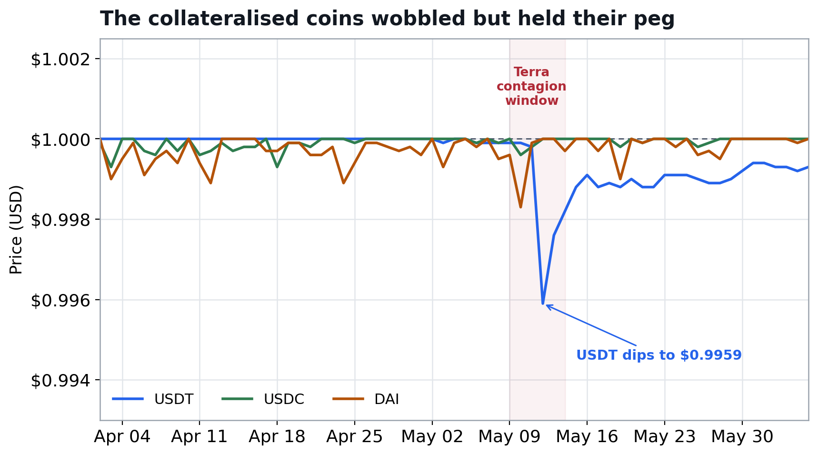
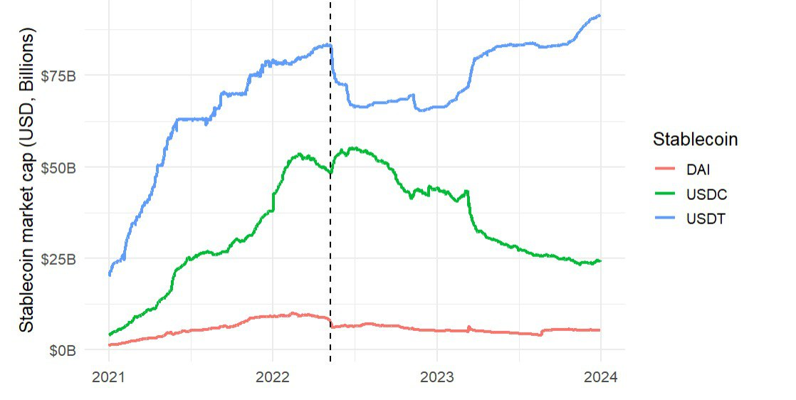
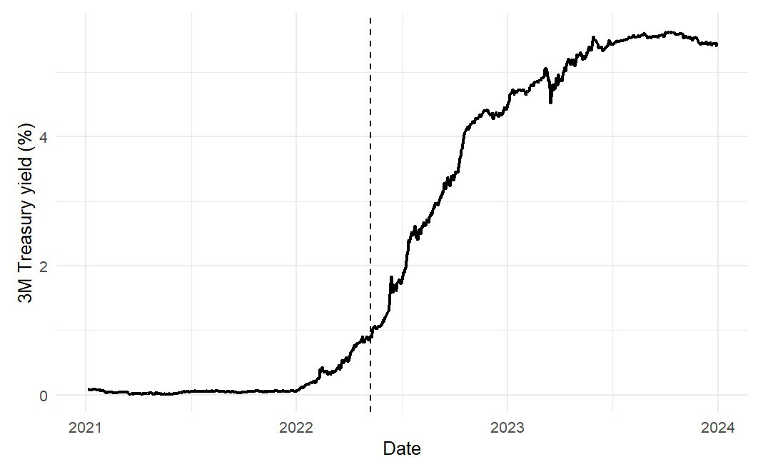
WHERE THE MONEY GOES · SECTION A Q2
Flight to safety, 2022: out of crypto entirely
Stage 1, within crypto: capital fled UST into fiat-backed coins
Stage 2, out of crypto: into US Treasuries
USDC, USDT and DAI wobbled (USDT briefly to $0.9959) but held, because each is redeemable for real off-chain reserves.
As the Fed pushed the 3-month yield toward 5%, investors abandoned non-yielding crypto dollars; USDC’s market cap rolled over through late 2022, and Tether itself moved reserves into T-bills.
Takeaway: trust flowed toward whatever was backed by the government balance sheet; the same destination as 2008.
Sources: provided stablecoin price & event datasets · GFC dataset (3-mo Treasury yield)
08

Slide 9

WHO BEARS THE LOSSES · SECTION A Q3
Same run, different safety net
2008 · Losses real, but contained
2022 · Losses total, and private
Holders of prime money funds faced losses, but public backstops capped the damage.
The Treasury’s temporary Guarantee Program, plus the Fed’s AMLF and CPFF facilities, supported the sector.
Reserve Primary investors ultimately recovered about $0.99 on the dollar.
A lender of last resort absorbed the tail risk [5][6].
Roughly $50–60B in UST and LUNA value evaporated, falling entirely on holders.
There was no insurance, no redemption guarantee and no lender of last resort.
Losses cascaded outward to 3AC, Celsius, Voyager and, ultimately, FTX.
Nothing stood between the run and the investor [3][9].
The dynamics were identical; institutional design, the presence or absence of a backstop, decided who absorbed the damage.
Sources: [3] NBER 2023 · [5] Yale 2025 · [6] Yale New Bagehot Project · [9] TheStreet 2025
09

Slide 10




SECTION B · DESIGNING FOR CONFIDENCE
A reserve that isn’t correlated with the panic
The failure to fix. UST’s “reserve” was its own sister token, an asset that collapsed at the exact moment it was needed. The fix is to make the reserve independent of crypto and resilient to a run [2][3].
1. Exogenous, liquid reserves
2. Redemption gates under stress
3. A mutualised backstop
Back every coin 1:1 with off-chain T-bills and cash, verified by frequent third-party attestation. Reserves that hold value when crypto falls cannot enter a death spiral.
A short, pre-disclosed delay on very large redemptions slows the first-mover stampede; the same tool that 2010 and 2014 reforms gave money market funds.
A shared fund, financed by a small levy on each issuer’s reserves, that acts as a private lender of last resort when a member coin comes under attack.
How it prevents another Terra
A T-bill reserve cannot hyper-inflate the way LUNA did, so the collateral survives the panic. Redemption gates buy time to meet withdrawals in an orderly queue rather than a stampede. The mutualised fund supplies the emergency liquidity Terra simply never had; the private equivalent of the public backstops that contained 2008.
Sources: [2] Anadu et al. 2025 (FRB Boston) · [3] Liu, Makarov & Schoar 2023 (NBER)
10

Slide 11

SECTION B · TRADE-OFFS
No fix is free
Yield-bearing reserves
Holding safe reserves earns yield, but passing it to users blurs the line between a stablecoin and a money fund, and large holders may still leave for direct T-bill exposure.
1
Redemption gates
Delaying redemptions protects the system but breaks the instant-liquidity promise that defines a stablecoin; the same unresolved tension regulators face with money funds [2].
2
Mutualised backstop
A shared rescue fund invites moral hazard and the unanswerable question of which coin to save, and a central rescue pool contradicts the decentralised ethos stablecoins were built on.
3
The real design problem: every safeguard trades away some of the immediacy, yield, or independence that made these instruments attractive in the first place. The failure was never the technology; it was the assumption that a dollar could be promised without anyone standing behind it.
Sources: [2] Anadu et al. 2025 (FRB Boston)
11

Slide 12
References & Data
[1] Gorton, G. (1988). Banking Panics and Business Cycles. Oxford Economic Papers, 40(4), 751–781.
[2] Anadu, K., Azar, P., Cipriani, M., et al. (2025). Runs and Flights to Safety: Are Stablecoins the New Money Market Funds? FRB of Boston, SRA Working Paper No. 23-02.
[3] Liu, J., Makarov, I., & Schoar, A. (2023). Anatomy of a Run: The Terra Luna Crash. NBER Working Paper No. 31160.
[4] Gorton, G., & Metrick, A. (2010). Regulating the Shadow Banking System. Brookings Papers on Economic Activity.
[5] Makhija, A. (2025). United States: Reserve Primary Fund Suspension, 2008. Journal of Financial Crises, Yale Program on Financial Stability.
[6] Yale New Bagehot Project. United States: Temporary Guarantee Program for Money Market Funds. newbagehot.yale.edu.
[7] Decrypt (2022). How Terra’s UST and LUNA Imploded. decrypt.co.
[8] Chainalysis (2022). UST’s Collapse & The Trades That Triggered It. chainalysis.com.
[9] TheStreet (2025). The Collateral Consequences of Terra Luna’s Collapse. thestreet.com.
[10] Bitstamp / Robinhood. Terra Network Collapse. bitstamp.net/learn.
Datasets. Provided ERC-20 stablecoin on-chain prices (UST/USTC, WLUNA, USDC, USDT, DAI, PAX) and event log, 2 Apr–2 Nov 2022; provided 2008 GFC series (3-month Treasury yield, S&P 500, gold, DXY, TED spread, Citi). 2022 price charts reproduced in the technical appendix.

